Slide 1
FILE SECURITY SYSTEM
S.SACHIN KUMAR-2014103557
A.K.SANDHYA-2014103558
M.PRIYAVARSHINI-2014103621

Slide 2
PROBLEM STATEMENT
There are possibilities that most important details in files may be hacked and can be used without proper authentication from the file owner. This may lead to malicious attack of files from the system and there are chances that they can be used inappropriately.

Slide 3
AIM OF THE WORK
The project deals with the security of file systems in personal computers.
To prevent the hacking activities ,the proposed system can protect the confidential files by authorizing the person from both the smart phone and the personal computer i.e., by providing mutual authentication features.

Slide 4
PROPOSED WORK
This system has two parts:
1. The application that runs on the user’s smart phone.
2. The application that runs on the Personal computer.

Slide 5
It implements 5 levels of security:
The username and password that the user has to enter to get in to the android application in the smart phone. The first half of the pass code to view the files is entered in the Smart phone. If correct the confirmation is sent to the PC.
The second half of the password is entered in the PC to access the files.
Restriction even to the admin to make the changes in the database content.
Set of personal questions to reset or change the password which is answerable by the user alone.
The files if accessed by someone accidentally other than the user, they cannot be copied or edited.

Slide 6
REFERENCE WEBSITES
https://www.tutorialspoint.com/db2/db2_database_security.htm
http://www.techrepublic.com/blog/microsoft-office/prevent-users-from-changing-data-by-using-access-form-control-properties/
http://www.makeuseof.com/tag/how-to-connect-your-cell-phone-to-your-pc-through-bluetooth/
http://www.instantfundas.com/2009/04/how-to-prevent-file-copying-deletion.html
http://www.exnol.com/prevent-file-data-copy-pc-usb-drive
http://paper.ijcsns.org/07_book/201005/20100506.pdf
https://technet.microsoft.com/en-us/library/ff936144.aspx
https://msdn.microsoft.com/en-us/library/windows/desktop/aa364399(v=vs.85).aspx
https://www.tutorialspoint.com/operating_system/os_security.htm
https://labs.portcullis.co.uk/blog/new-restricted-admin-feature-of-rdp-8-1-allows-pass-the-hash/

Slide 7
LITERATURE SURVEY

Slide 8
1.“BLUETOOTH ENABLED MOBILE PHONE REMOTE CONTROL FOR PC”
Qadeer, M.A. , Agrawal, R. ,Singhal A. and Umar. S
International conferences on Advanced Computer Control, 2008.IEEE DOI 10.1109/ ICACC .2009.91

Slide 9
TECHNIQUES | This work confers an application which makes possible to use a Bluetooth enabled mobile phone to remote control home appliances that are connected to the PC as well as other computer applications.
DATA SET | Bluetooth, mobile phones, home networking, PAN, wireless networks, J2ME, Java.
ADVANTAGES | The time for searching the device can be eradicated if the same PC is used again and again by storing the serial port service URL and using it directly to open connection. Bluetooth enabled mobile devices can be used to control home appliances as well.
INFERENCE | Better visualization can be provided by displaying the entire screen of pc on mobile. Compatibility with current day smart phones need additional client side programming. Need to design the hardware accordingly.

Slide 10
2. “POCKETDROID-A PC REMOTE CONTROL”
Chaitali Navasare, DeepaNagdev
International Conference on Information and Network Technology
2012 vol. 37.

Slide 11
TECHNIQUES | The user can connect to any computer having Server Application running on it. It is basically an Android based Mobile Application for controlling a Target PC. User can have full access of the Target PC, provided its IP address is known.
DATA SET | Android, IP address, JAVA, Linux OS, pervasive computing, remote desktop, remote visualization, smart phone, wireless handheld devices.
ADVANTAGES | Running of basic Linux or Windows Commands via android application. Provide a mechanism for graphically interacting with files and folders of target PC. ) It allows user to troubleshoot and solve problems faster in remote pc. Remote virtualization.
INFERENCE | Better visualization can be provided by displaying the entire screen of pc on mobile. Data leakage may happen. Requires more memory for storing data and log information.

Slide 12
3. “SESSION KEY EXCHANGE AND MUTUAL AUTHENTICATION SCHEME BETWEEN MOBILE MACHINES IN WLAN BASED AD HOC NETWORKS”
Hyosun Roh, Souhwon jung - School of Electronic Engineering, Soongsil University, Korea
PUBLISHED IN: International Conference on Information and Communication Technology Convergence (ICTC).
DATE OF CONFERENCE: 17-19 Nov. 2010

Slide 13
TECHNIQUES | The main idea of this paper is that non-interactive session key exchange uses the mobile machine's ID and mutual authentication without communication with an authentication server whenever a data transmission occurs between the mobile machines.
DATA SET | Authentication , Mobile Communication , Servers ,Delays , Ad hoc networks ,Message authentication .
ADVANTAGES | The proposed scheme is secure against man-in-the-middle attack, impersonation attack, and modification attack.
INFERENCE | M2M is undergoing security problems such as physical attacks, compromise of credentials, configuration attacks, protocol attacks, attacks on the core network, and user data and identity privacy attacks . Therefore, M2M require basic security functions like secure key agreement, data confidentiality, data integrity, and mutual authentication for secure communication between the machines.

Slide 14
4. “ AN ENHANCED REMOTE MUTUAL AUTHENTICATION SCHEME USING SMART CARDS ”
Jie Gu , Zhi Xue , Yan Zhu , Fangbiao Li , Xiao Chen
CONFERENCE: symposium on ICT and energy efficiency and workshop on information theory and security(CIICT 2012)
ISBN: 978-1-84919-547-8
Location: Dublin, Ireland
Conference date:4-5 July 2012.
Publisher: IET.

Slide 15
TECHNIQUES | Mutual authentication is a process or technology in which both entities in a communications link authenticate each other before conducting any business. This can help in eliminating password hacking.
DATA SET | Mutual authentication ,Smart cards ,Security , Cryptanalysis.
ADVANTAGES | It is gaining acceptance as a tool that can minimize the risk of online fraud in e-commerce and other network application. The scheme can withstand guessing attack, forgery attack, denial of service attack and is easily realized in the practical resource-limited environment.
INFERENCE | This scheme ,however ,suffers from parallel session attack and replay attacks. Vulnerable to masquerade user attack, offline password guessing attack.

Slide 16
5. “MOBILE ENCRYPTION FOR LAPTOP DATA PROTECTION”
Y.-W. Kao, X. Zhang, A. Studer, A. Perrig
PUBLISHED IN:Volume 6, Issue 4, 2012 ,
pg. 291 – 298
PUBLISHER: IET

Slide 17
TECHNIQUES | If a laptop is stolen, the data stored on it is easily leaked; which may cause serious consequences. Encrypting files by encryption keys is a general solution; however, if the decryption keys are also stored on laptops, the files can also be decrypted by adversaries easily. To solve this problem, this paper proposes the Mobile Encryption for Laptop data Protection (MELP) system.
DATASET | Public and Private key cryptography ,Mobile computing
ADVANTAGES | Use of encryption and decryption for securing the files in pc rather than using passkey. In addition of a simple password, this method adds further security to the system.
INFERENCE | The reason of adopting a mobile phone is that at least one simple confirmation of execution must be performed by a user, and the reason of adopting an online server is that if both user's laptop and mobile phone are stolen, users can still disable the online decryption process on the server.

Slide 18
MODULES

Slide 19
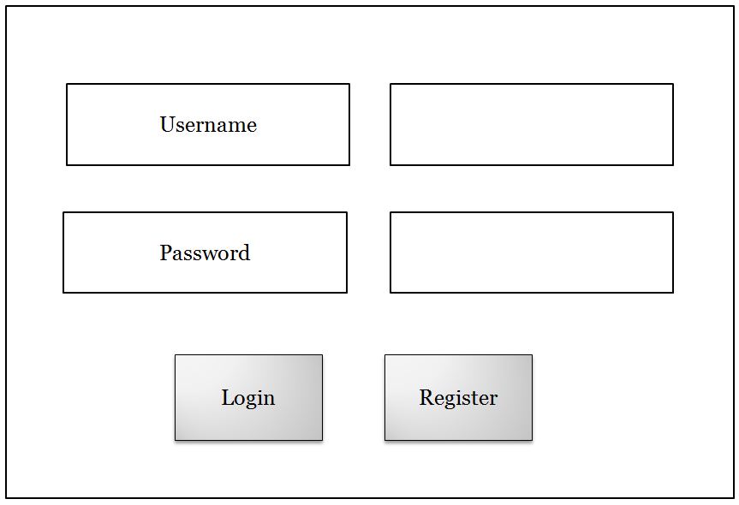
MODULE 1:SMART PHONE UI M 1.1 : ENTRY PAGE
INPUT : User name and password entered by the user.
OUPUT :
1) Register : Redirected to M 1.2
2) Login : Redirected to M 1.3
PROCESS : Validating and authenticating the user by comparing the input with the DB contents.

Slide 20
ALGORITHM :
Login:
1.Enter username and password in Smartphone entry page.
2.if ((username && password)==valid)
3. Redirect to login page
4. else
Reenter username and password
Register:
Redirect to Register page.

Slide 21
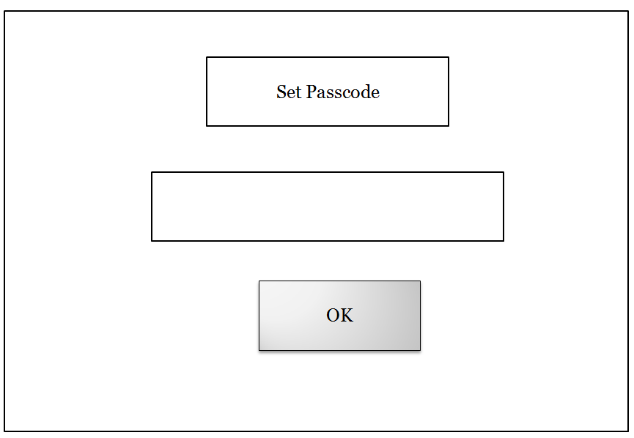
M 1.2 : REGISTER PAGE
INPUT : Pass code entered by the user.
OUTPUT : Redirected to M 1.3
PROCESS : The first half of the entered pass code is stored in one column and the other half in the other column.

Slide 22
ALGORITHM:
1.Set Passcode
2.Length=Strlen(passcode)
3.for(i=o to length/2)
Store in Column1;
for(Length/2 to length)
Store in column2;
4.Redirect to M1.3

Slide 23

M 1.3 : LOGIN PAGE
INPUT : First half of the pass code
OUTPUT : Alert message in the smart phone and acknowledgement is sent to the PC .
PROCESS : Verifying the entered pass code with the DB contents .

Slide 24
ALGORITHM :
1.Enter Passcode1.
2.If(passcode1==Valid)
Send Alert message1 to PC.
3.else
Reenter passcode1.

Slide 25
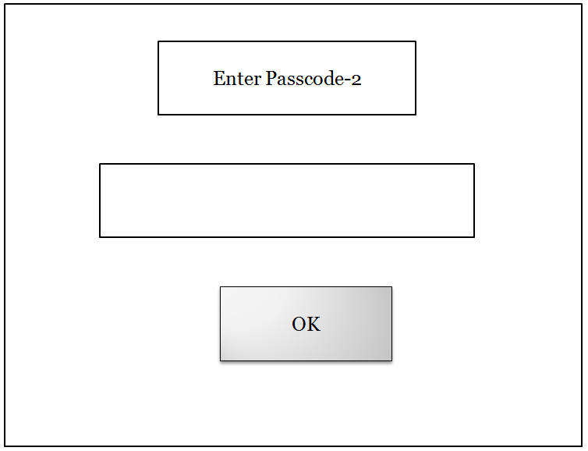
MODULE 2: PERSONAL COMPUTER UI M 2.1 : HOME PAGE
INPUT :
1) Acknowledgement received from the smart phone.
2) Second half of the pass code entered by the user .
OUTPUT : Redirected to M 2.2
PROCESS : Verifying the entered pass code with the DB contents .

Slide 26
ALGORITHM:
After the acknowledgement is received from user's smart phone
do
1) Read the second half of the pass code from pc.
2) Check whether the entered pass code matches with the DB contents.
-yes ,leave the current module and redirect to M.2.2.
-else ,throw error message.

Slide 27
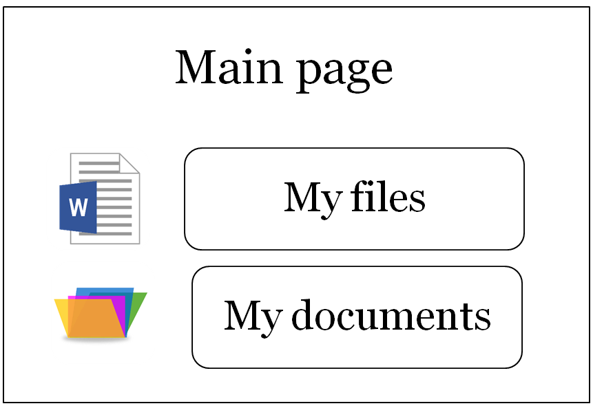
M 2.2 : MAIN PAGE
CONTENT : List of all folders and files imported by the user.
OPERATIONS :
1) The user can view the contents of the files and folders.
2) The page gets redirected to M 2.3 when the user tries to edit or copy the file.

Slide 28

M 2.3
INPUT : Pass code entered by the user .
OUTPUT : Enables the user to edit or copy the file.
PROCESS : Verifying the entered pass code with the DB contents .

Slide 29
ALGORITHM :
1) enter the pass code.
2) Check for if correctness
-yes , allow to copy or edit
-no , prompt to re-enter the pass code.

Slide 30
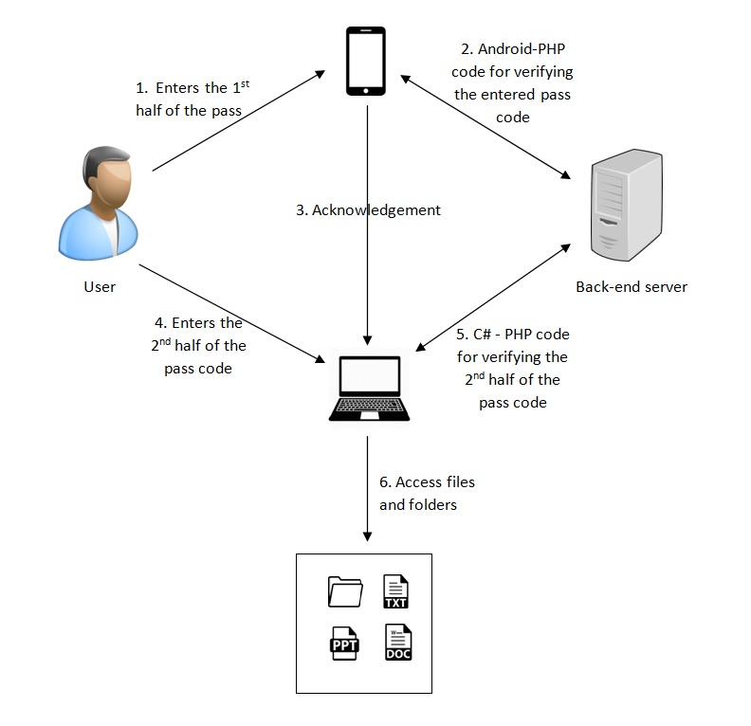
BLOCK DIAGRAM

Slide 31
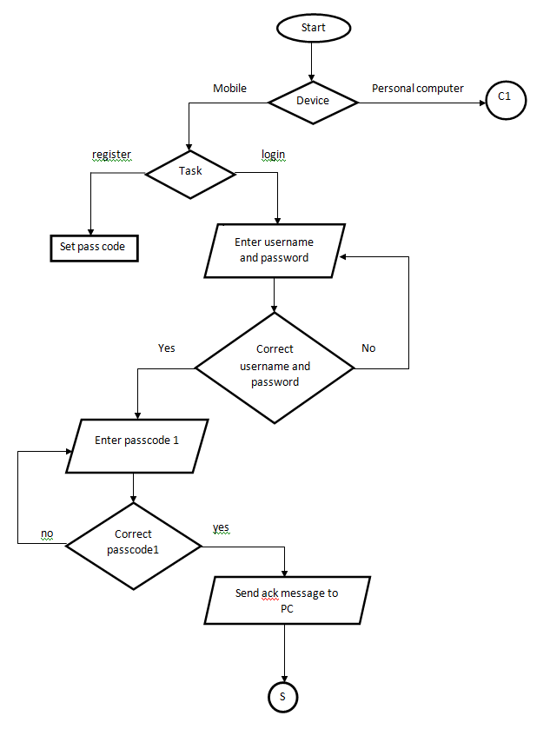
FLOW CHART

Slide 32
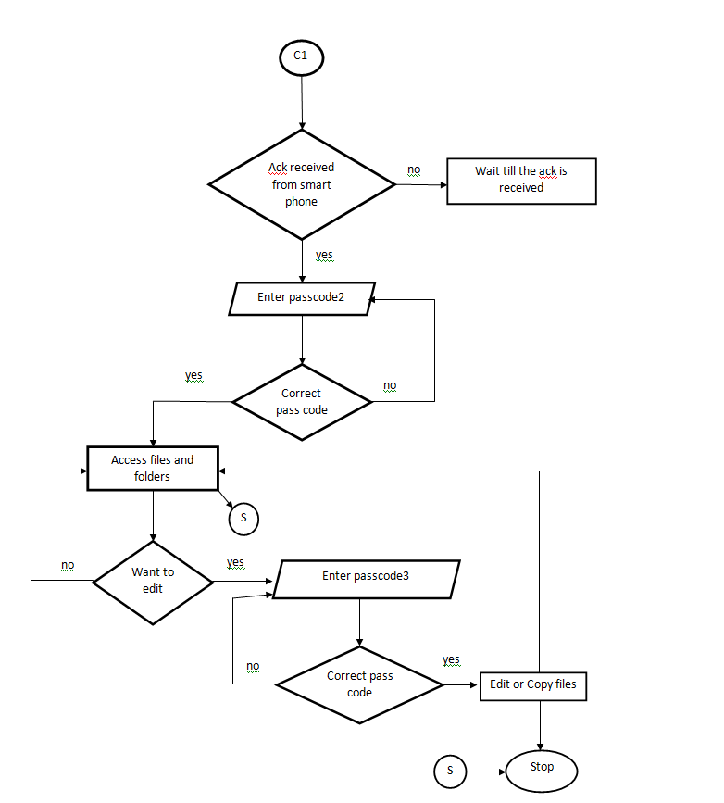

Slide 33
APPLICATION AND USAGE
This projects aims to protect and secure user's confidential files .
Hence it can be used in many areas like business, banks, military, government offices, educational institutions and so on.
for users who wants to protect his confidential files.
for banks which wants to keep their customer's bank details.
for military purpose where there may be situation to save some important files and keep them secure from enemy(hackers).
for educational institutions which may require to keep the mark sheets and students details secure.

